Slide 1


Part 0: Installation & Introduction
Python Beginners-Course
Recommended Vido: https://www.youtube.com/watch?v=Z1Yd7upQsXY
Martin Radenz (radenz@tropos.de)
Willi Schimmel (willi.schimmel@uni-leipzig.de)
Teresa Vogl (teresa.vogl@uni-leipzig.de)
LIM, 05. October 2020

Slide 2

What is Python?
An
open source
cross platform
general purpose
multi-paradigm
interpreted
programming language
free
used for (almost) everything
imperative, object-oriented, functional
not compiled as FORTRAN or C
but scientific stack also with external libraries
Notes:
first version 1991
GUI, Web, scripting

Slide 3
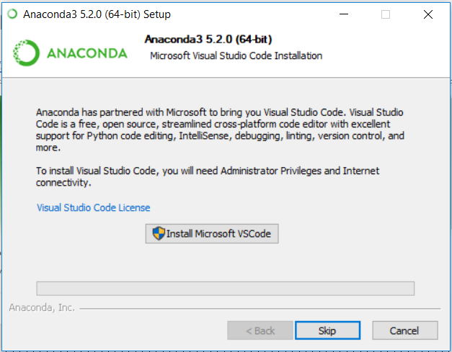
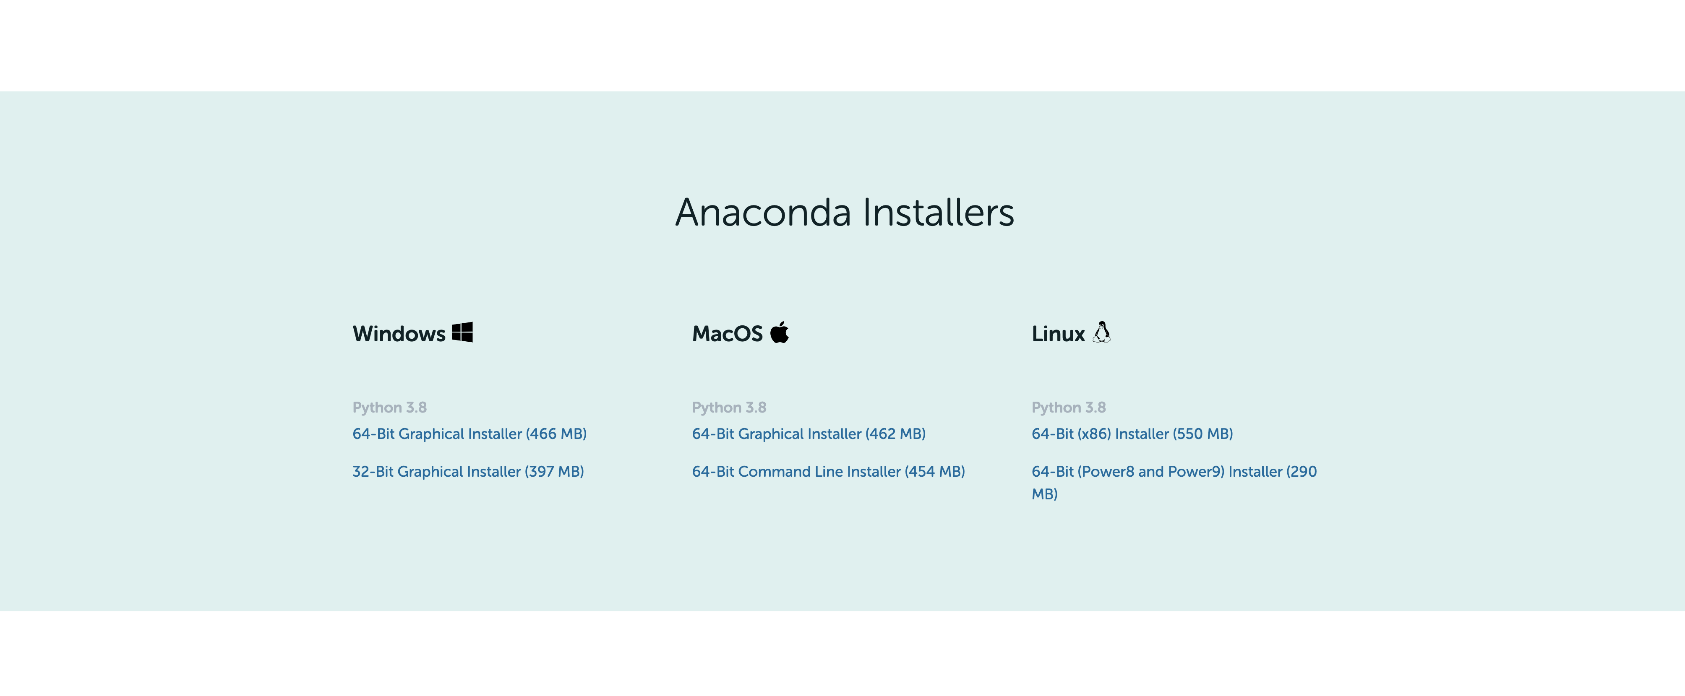
Anaconda Installation
https://www.anaconda.com/products/individual
VSCode Editor -> skip

Slide 4
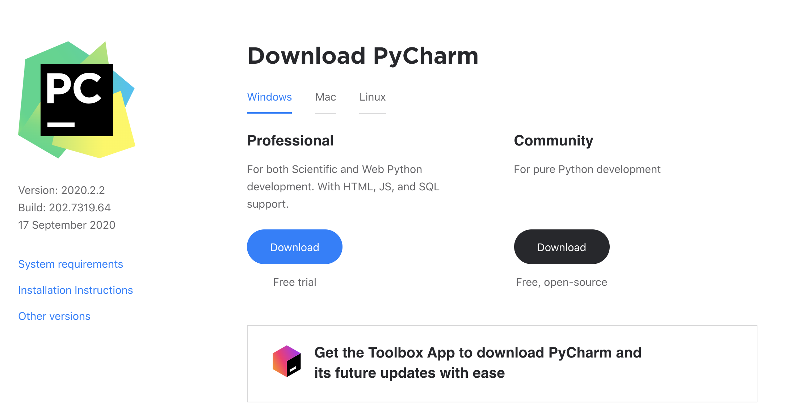
PyCharm IDE Installation
Professional Version free for
University Students
with JetBrains Account
https://account.jetbrains.com/login
https://www.jetbrains.com/pycharm/download/#section=windows

Slide 5
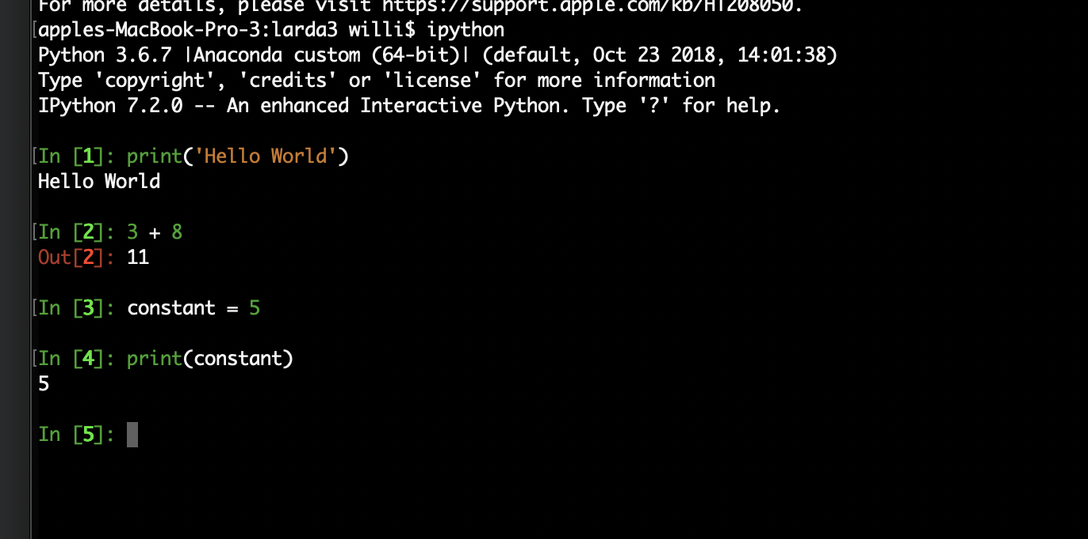
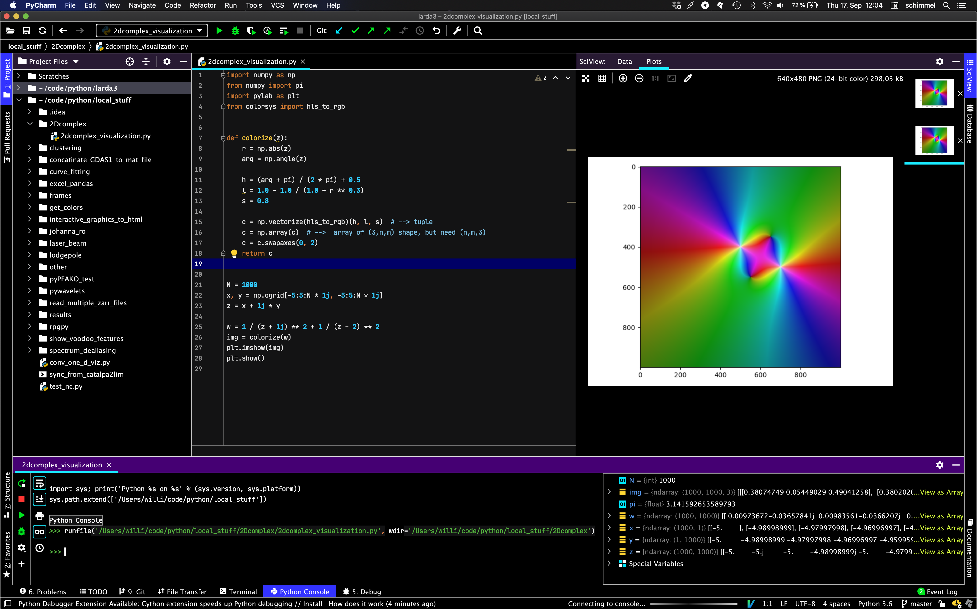
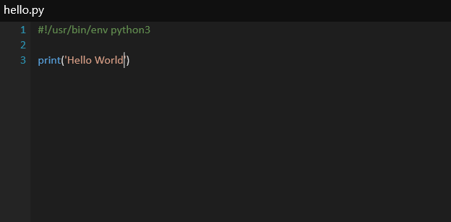
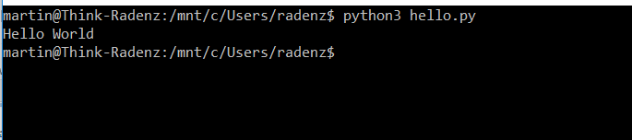
How to run the code?
ipython console
IDE (PyCharm)
script

Slide 6
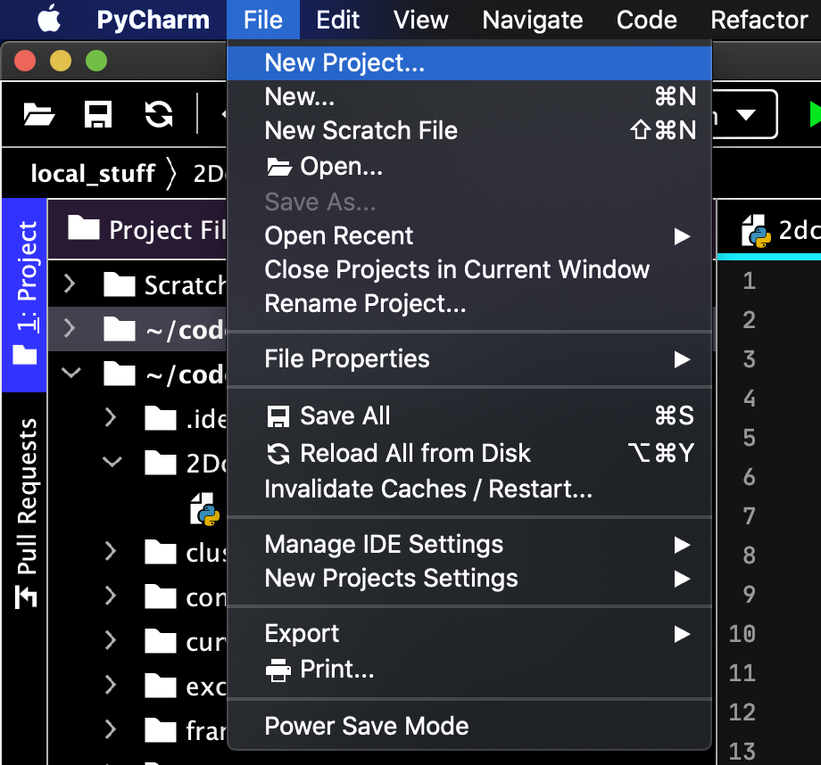
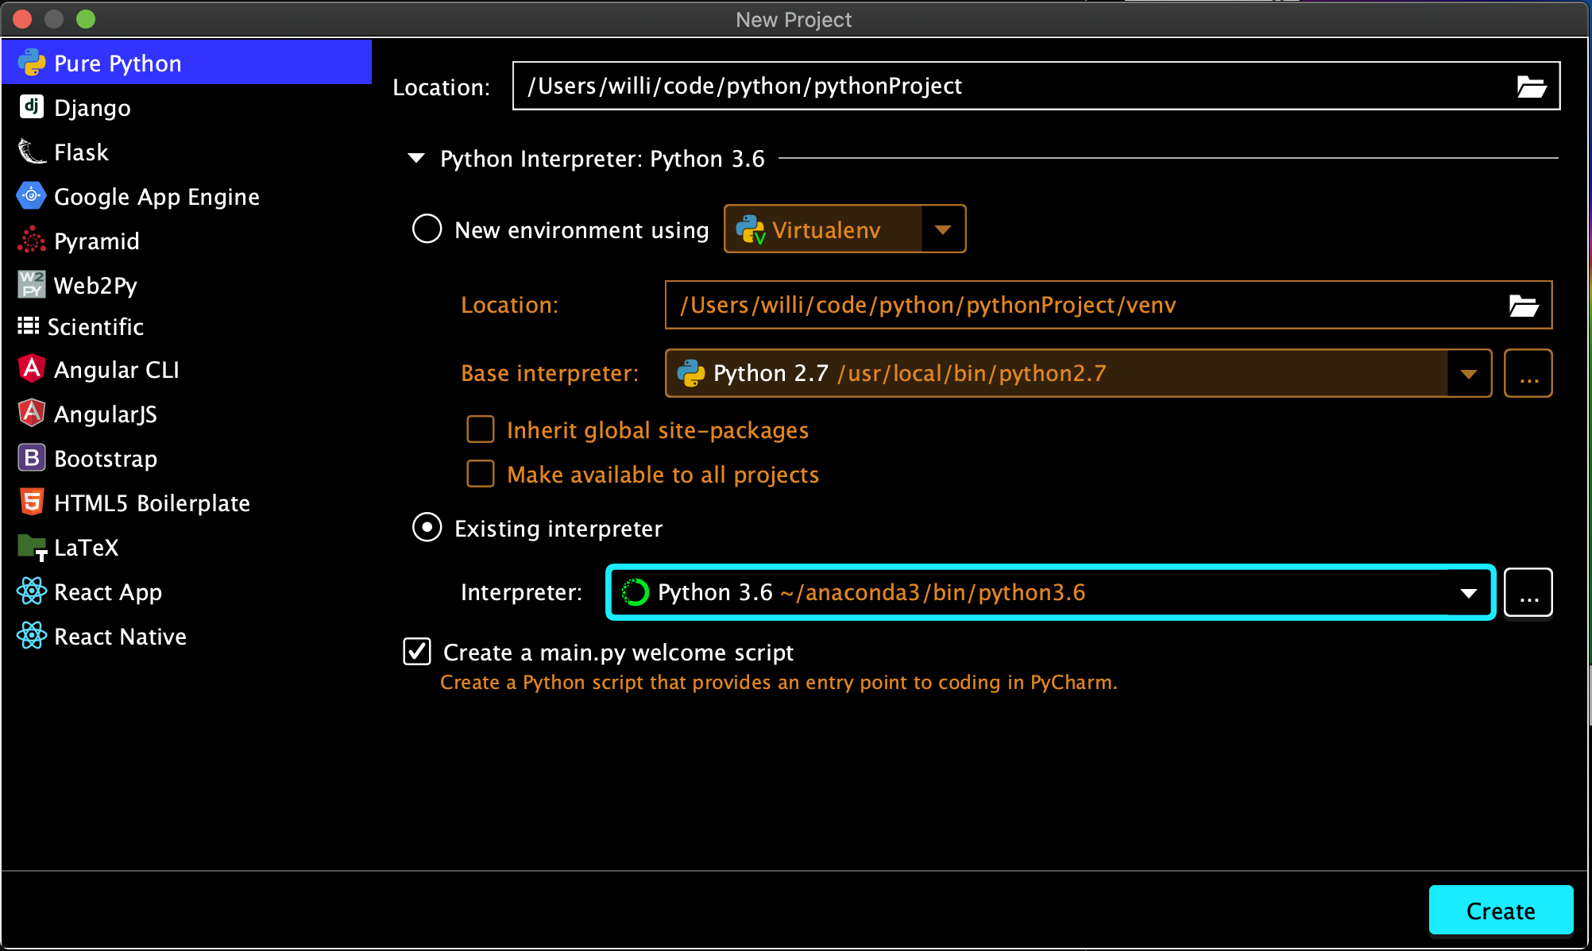
PyCharm Configuration
Adding a New Project:
Specify location of your project & configure interpreter:
optional
Add a Python Interpreter like Anaconda: PyCharm → Preferences --

Slide 7
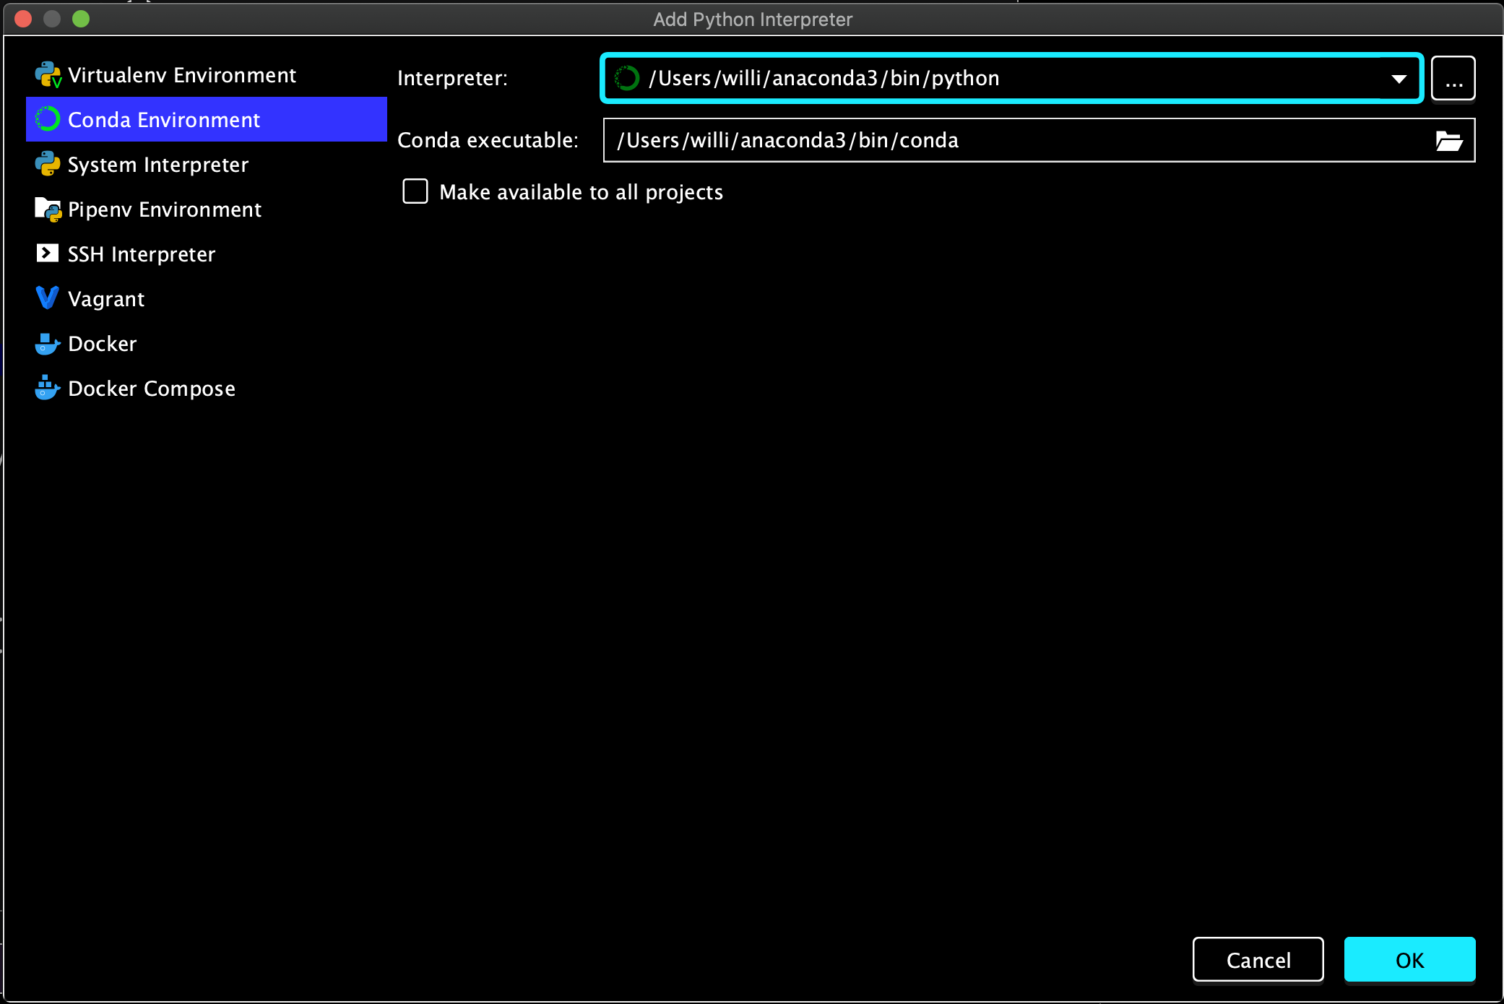
PyCharm Configuration
Specify path to Anaconda3 Python interpreter &
conda executable usually:
/Users/[name]/anaconda3/bin/python
/Users/[name]/anaconda3/bin/conda
Path specification depends on operating system
Add a Python Interpreter like Anaconda: PyCharm → Preferences --

Slide 8
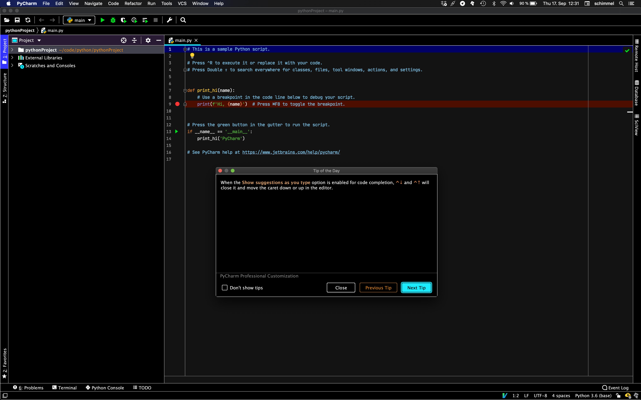
PyCharm Configuration
…done
Add a Python Interpreter like Anaconda: PyCharm → Preferences --

